Slide 1

SMART INDIA HACKATHON 2026
TITLE PAGE
Problem Statement ID – SIH26186
Problem Statement Title - AI-Based Predictive Personnel Stress and Welfare Monitoring System for Uniformed Forces
Theme - MedTech / Biotech / HealthTech
PS Category - Software
Team ID -
Team Name – Tech Atelier

Slide 2
TECH ATELIER
PROPOSED SOLUTION
Our Solution
AI monitoring system features
A software-based AI system that continuously monitors physiological and activity signals of uniformed personnel.
It predicts stress and fatigue risk using machine learning and personalized baseline.
The system provides early warnings and welfare recommendations for timely intervention.
A user-friendly dashboard displays risk level, trend and suggestions for better decision making.
Continuous
Predictive
Early warnings
User
monitoring
analytics
Provides early
dashboard
Software-based AI
Predicts stress and
warnings and
Displays risk level,
system that
fatigue risk using
welfare
trend and
monitors
machine learning
recommendations
suggestions for
physiological and
and personalized
for timely
better decision
activity signals of
baseline.
intervention.
making.
uniformed
personnel.
@SIH Idea Submission
2

Slide 3
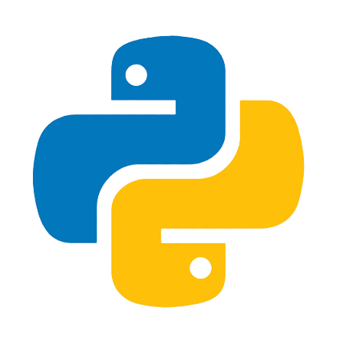



TECH ATELIER
TECHNICAL APPROACH
Software Python, Pandas, NumPy, SciPy, Scikit-learn
AI/ML XG Boost
Data Duty hours, Deployment records, Leave history, Workload data
Visualization Streamlit dashboard
@SIH Idea Submission
3

Slide 4
TECH ATELIER
FEASIBILITY AND VIABILITY
Feasibility
Uses existing and easily accessible AI/ML technologies such as Python and Scikit-learn.
Can initially be developed using public physiological datasets, without requiring hardware.
The system can be deployed as a web-based dashboard using Streamlit.
Requires relatively low-cost computing resources for the prototype.
Viability / Advantages
Enables early prediction of stress and fatigue instead of only detecting current stress.
Provides personalized risk assessment using individual baseline values.
Supports timely rest and welfare interventions.
Privacy-conscious design can limit access to sensitive physiological information.
Helps improve personnel well-being, alertness and operational readiness.
@SIH Idea Submission
4

Slide 5
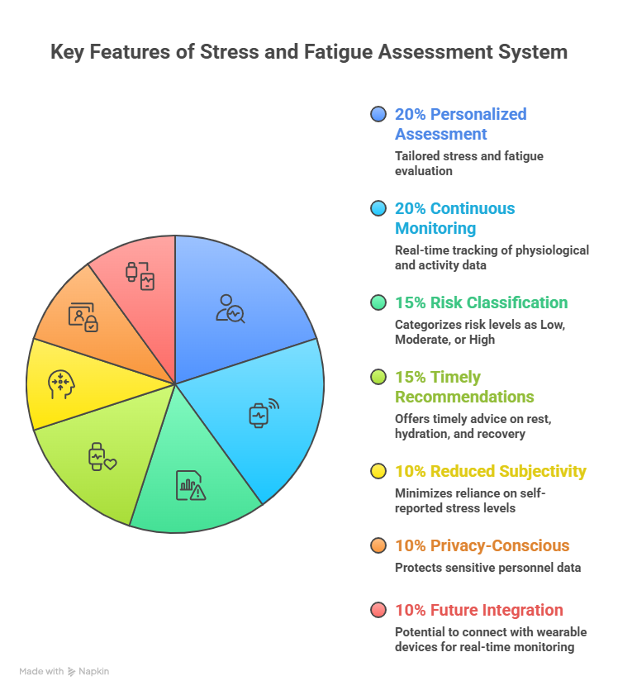
TECH ATELIER
IMPACT AND BENEFITS
Enables early prediction of stress and fatigue in uniformed personnel.
Improves personnel well-being and operational readiness.
Supports timely intervention before stress or fatigue becomes severe.
Promotes data-driven welfare management.
Can be scaled for large-scale personnel monitoring.
Personalized Assessment – Tailored stress and fatigue evaluation.
Continuous Monitoring – Real-time tracking of physiological and activity data.
Risk Classification – Categorizes risk levels as Low, Moderate, or High.
Timely Recommendations – Provides advice on rest, hydration, and recovery.
Reduced Subjectivity – Minimizes reliance on self-reported stress levels.
Privacy-Conscious – Protects sensitive personnel data.
Future Integration – Can be connected with wearable devices for real-time monitoring.
@SIH Idea Submission
5

Slide 6
TECH ATELIER
RESEARCH AND REFERENCES
Key References
McConnon, A. D., Nash, A. J., Roberts, J. R., Juni, S. Z., Derenbecker, A., Shanahan, P., & Waters, A. J. (2025). Incorporating AI into military behavioral health: A narrative review. Military Medicine, 190(9-10), e1870-e1881.
Leightley, D., Williamson, C., Korbacz, A., Curcin, V., Marshall, I. J., & Greenberg, N. (2026). Effectiveness of AI-based interventions in workplace mental health: a systematic review and narrative synthesis. British Medical Bulletin, 157(1), ldag007.
Rana, R., Higgins, N., Stedman, T., March, S., Gucciardi, D. F., Barua, P. D., & Joshi, R. (2025). Passive AI detection of stress and burnout among frontline workers. Nursing Reports, 15(11), 373.
@SIH Idea Submission
6

